Slide 1
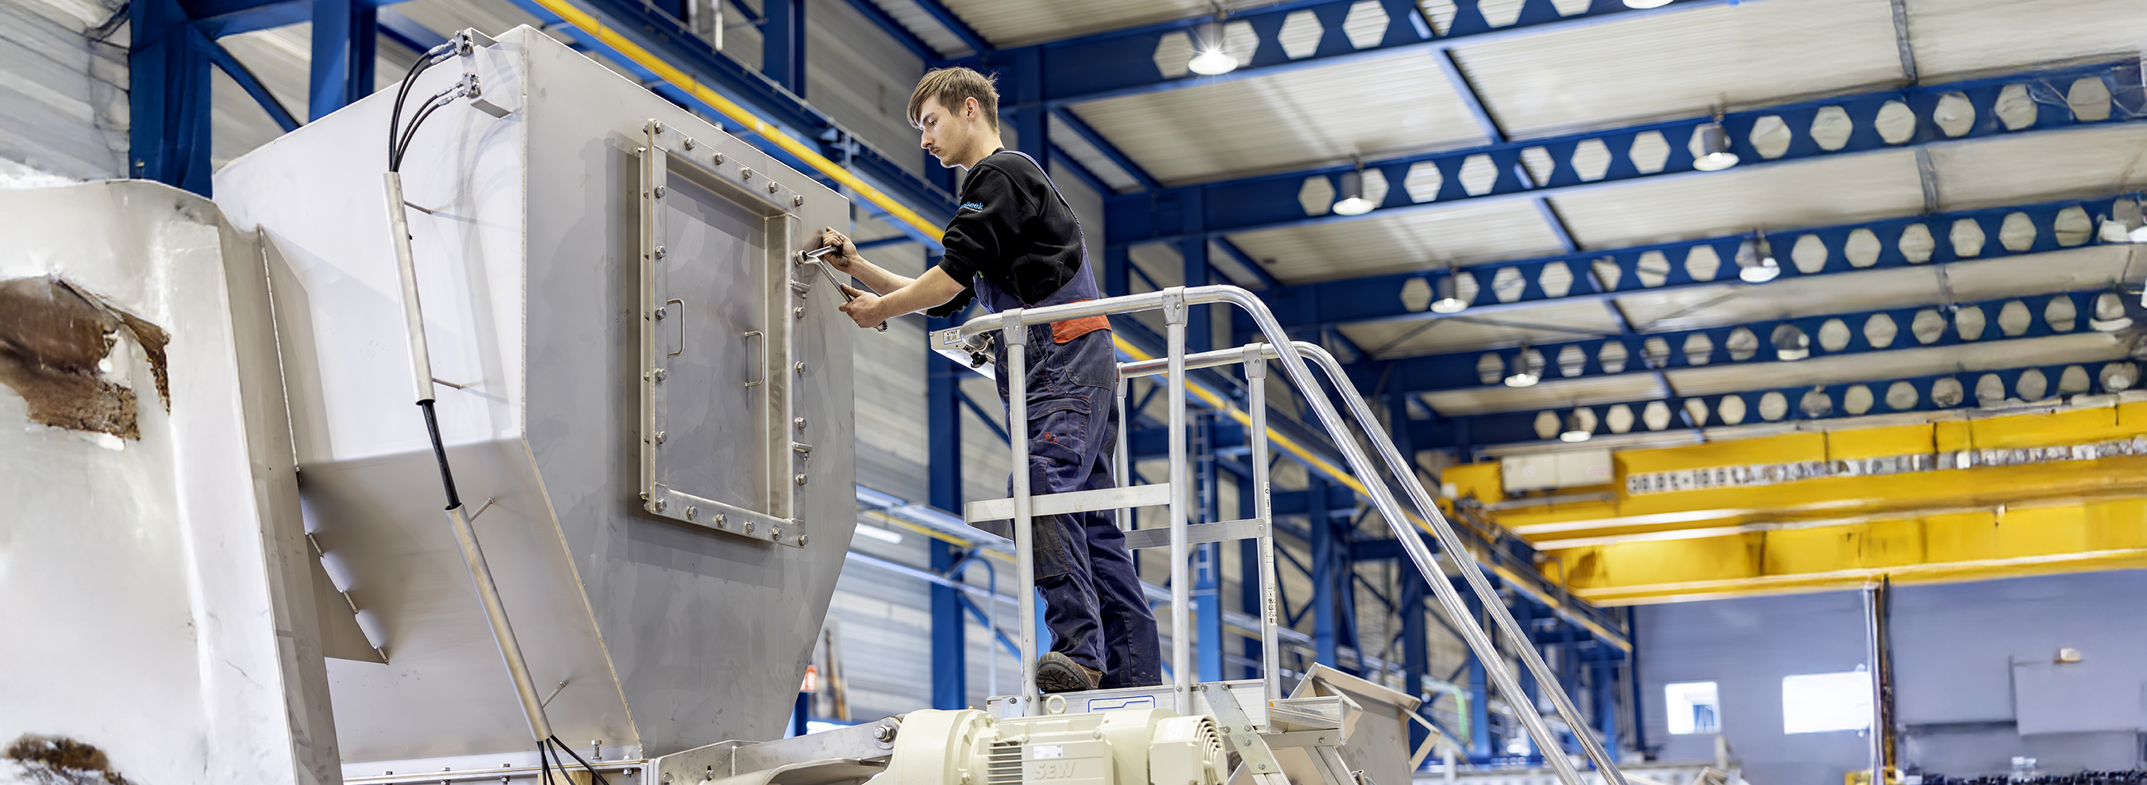
Toolbox Working at height - Fall hazard
Company name and date

Slide 2

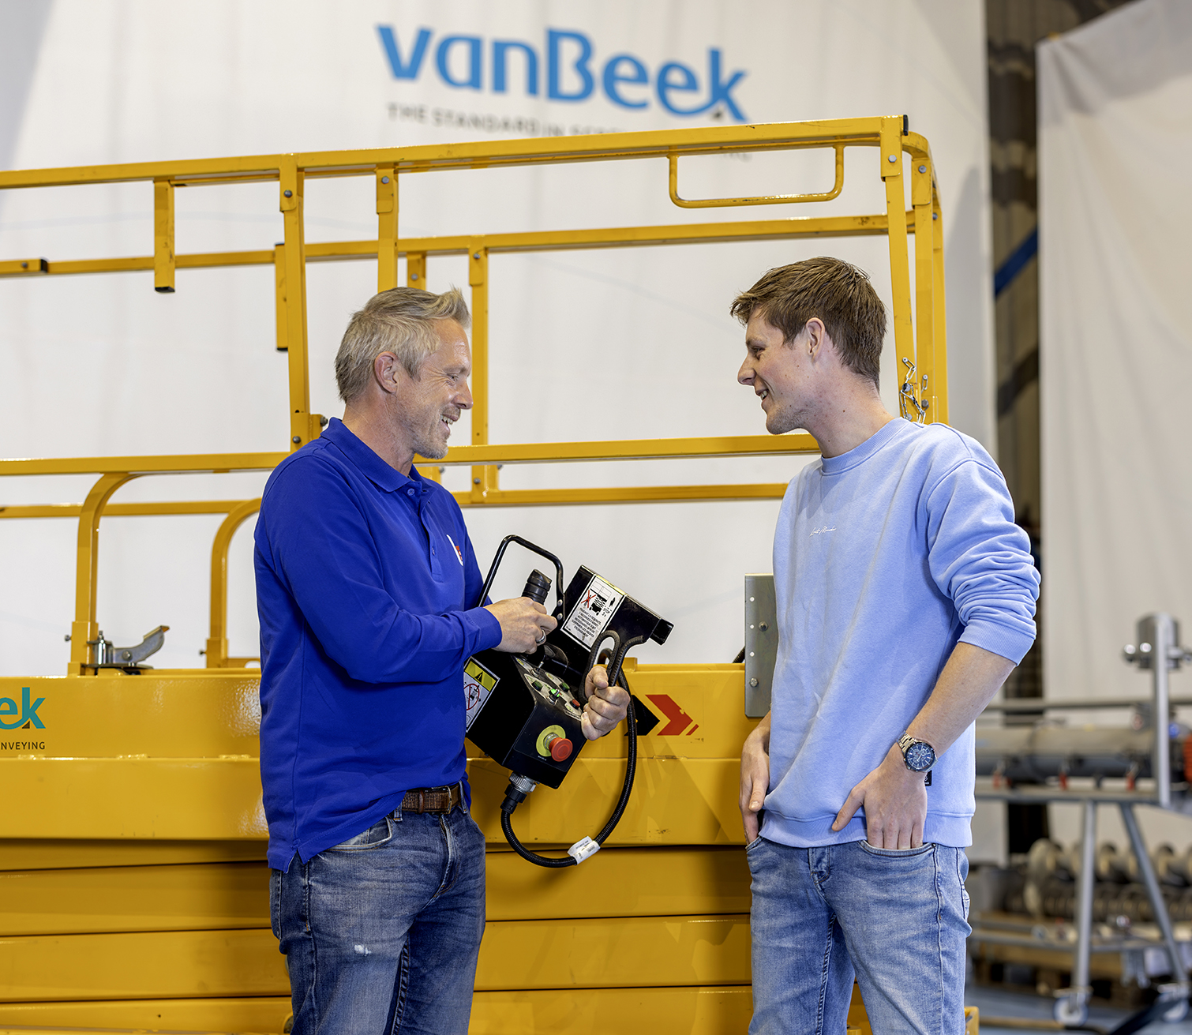
When is there a fall hazard?
Safe and healthy working practices | Working at height - Fall hazard
There is a risk of falling when:
The standing height exceeds 2.5 metres.
There are risk-increasing circumstances:
obstacles - protruding parts
working near water
openings in floors

Slide 3
What work is carried out at height here?
Safe and healthy working practices | Working at height - Fall hazard
Text:
Notes:
Practical examples from the company, photos

Slide 4
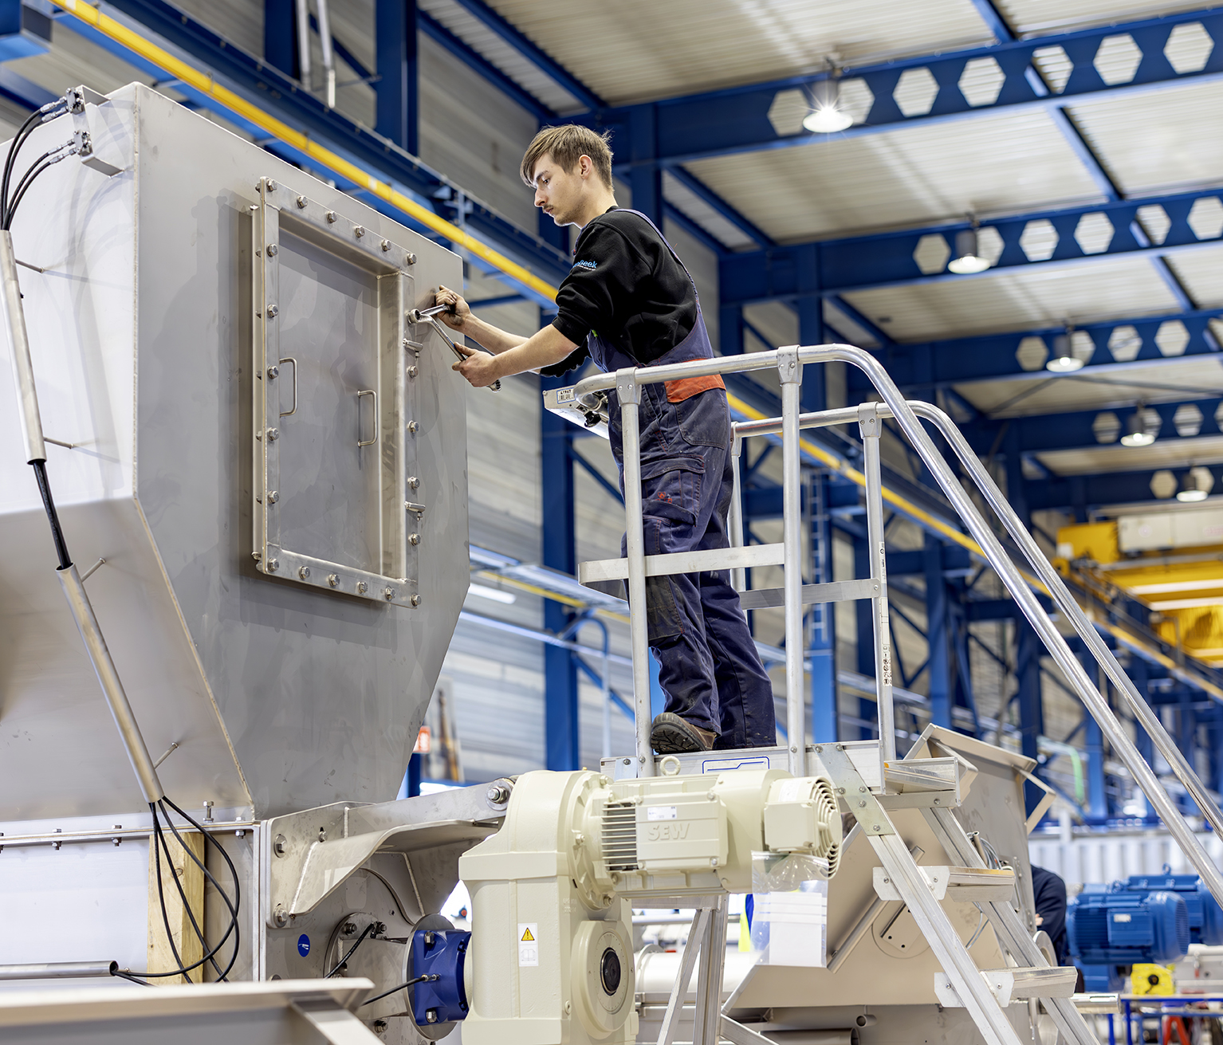
Contents
Safe and healthy working practices | Working at height - Fall hazard
What is working at height?
What are the risks?
What are the rules?
What can you do yourself?

Slide 5
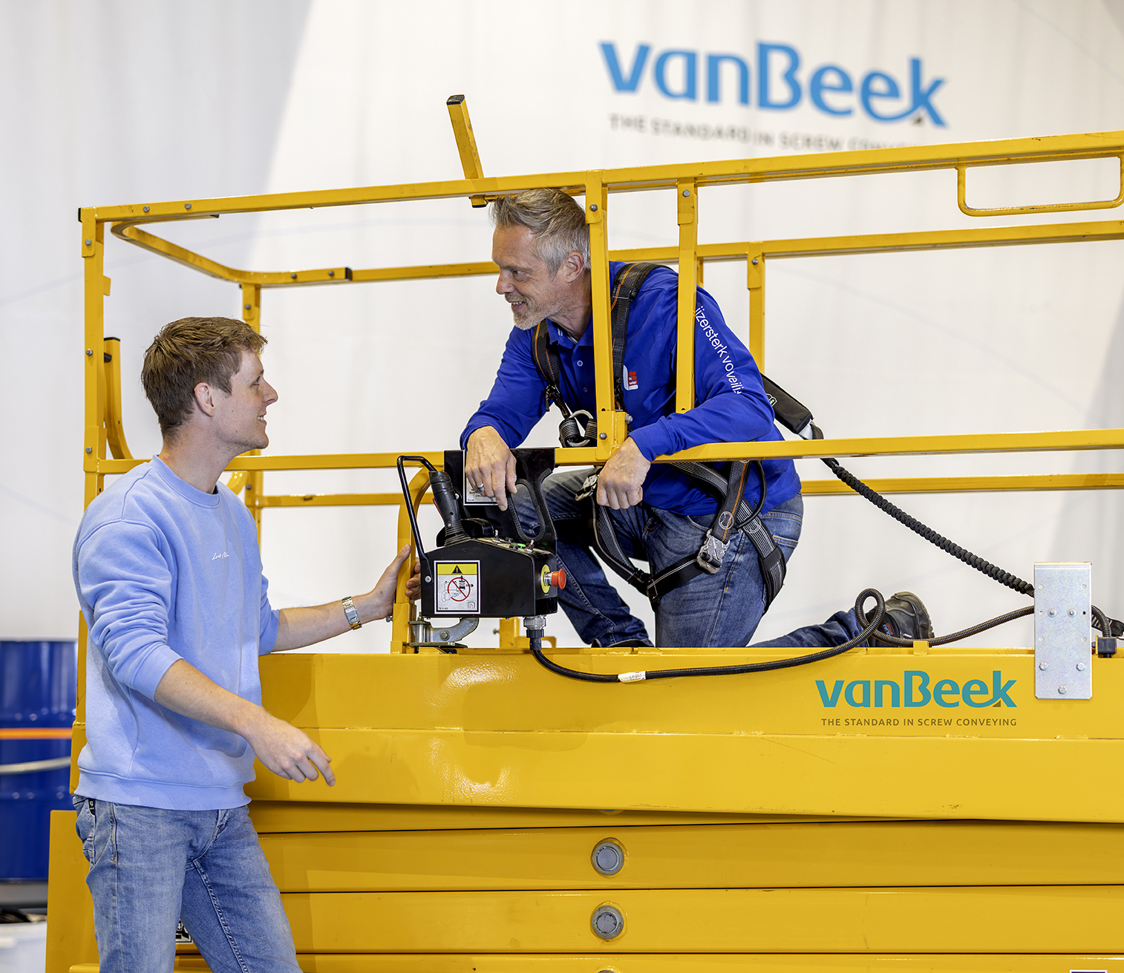
Risks of working at height
Safe and healthy working practices | Working at height - Fall hazard
Fall hazard.
Being hit by falling tools, extensions or other objects.
Longer escape time in the event of an emergency.

Slide 6
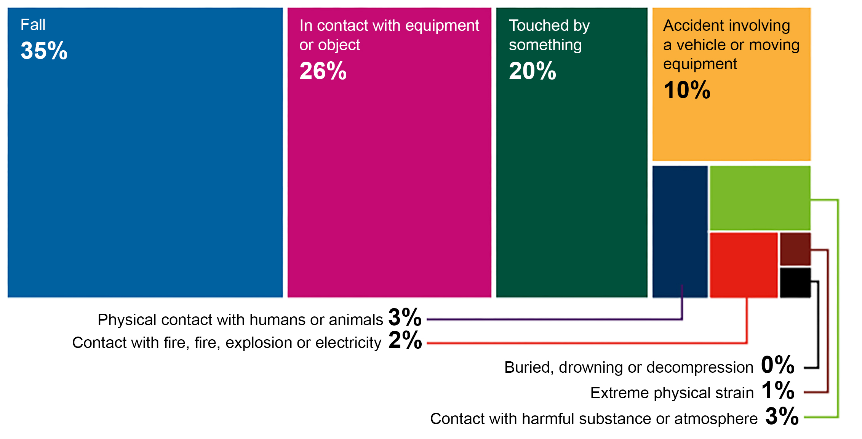
Safe and healthy working practices | Working at height - Fall hazard
Figures
Notes:
NOT industry-specific!
Source: https://www.nlarbeidsinspectie.nl/publicaties/rapporten/2024/08/26/monitor-arbeidsongevallen-2023

Slide 7
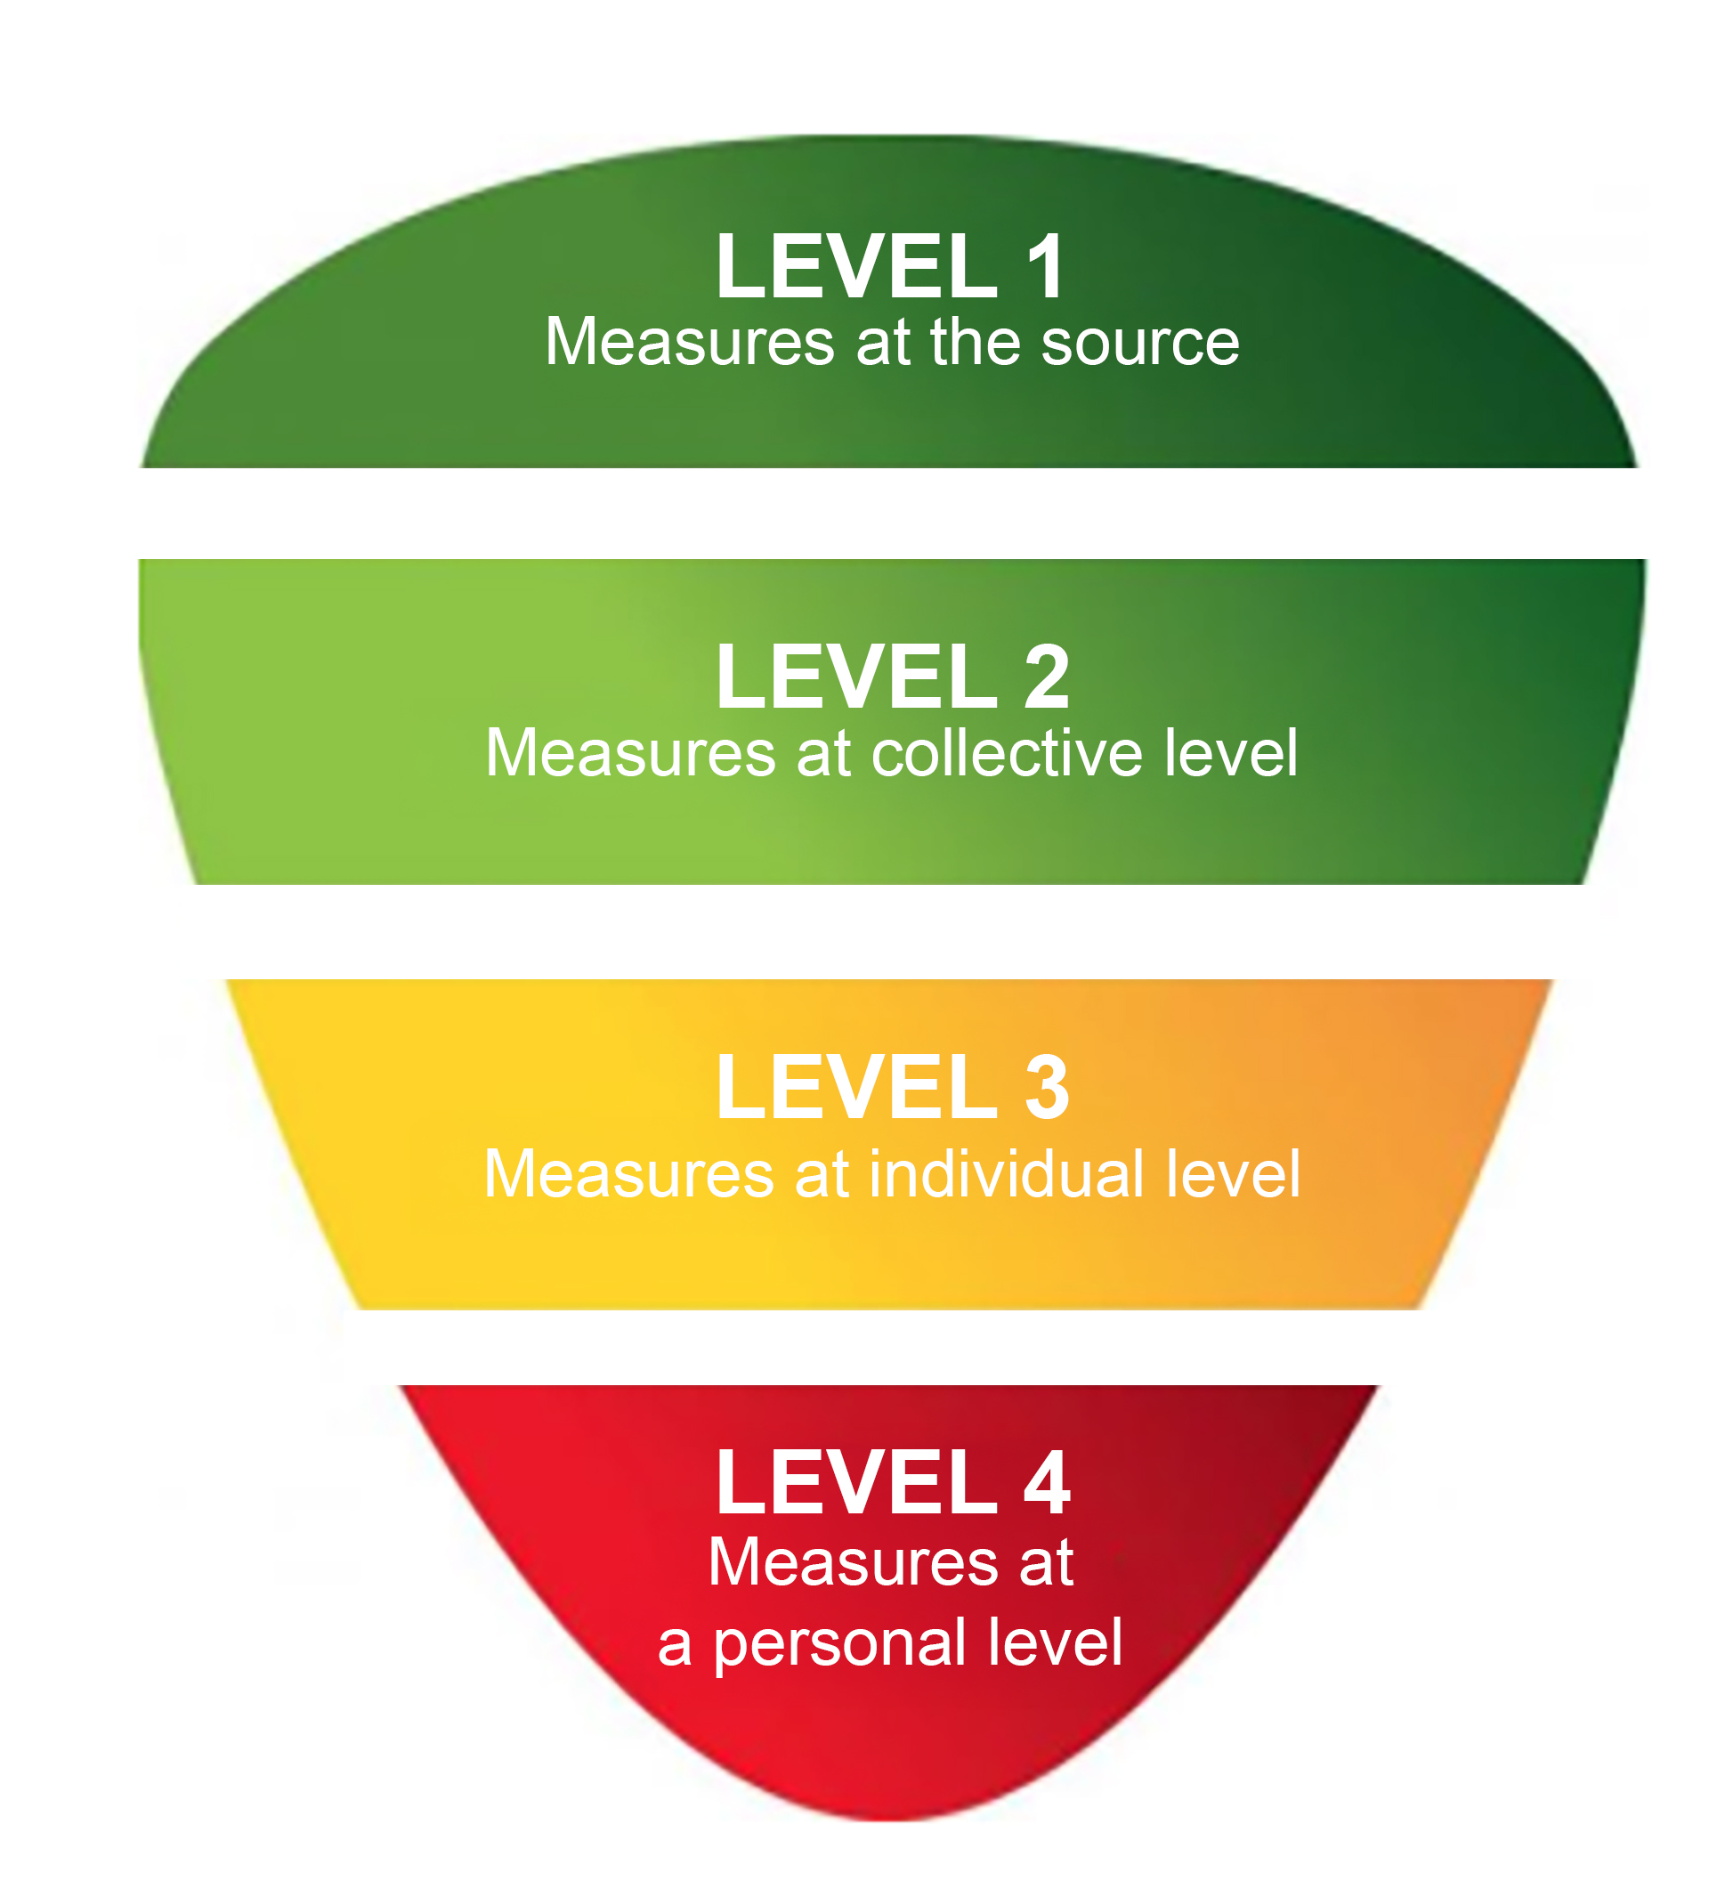
Safe and healthy working practices | Working at height - Fall hazard
What are the rules?
Occupational health strategy
Source approach: carry out work in such a way that there is no or less fall hazard, prefabrication, different working methods, etc.
Collective/technical measures: install edge protection, scaffolding, etc.
Individual measures: work with permanent fall protection systems.
Personal measures: working with temporary fall protection systems.
Notes:
When working at height, the individual and personal measures are close together, but there is a difference in the required competencies of the employees.

Slide 8
Safe and healthy working practices | Working at height - Fall hazard
What are the rules?
Fall hazard improvement check (for temporary work at height)
Approved industry tool for assessing work situations and assisting in the selection of a tool in accordance with the occupational health strategy:
Level 1: aerial work platform, mobile scaffold, fall protection.
Level 2: temporary edge protection, fall protection.
Level 3: ladder or staircase, fall protection.
Level 4: personal protective equipment, fall protection.

Slide 9
Safe and healthy working practices | Working at height - Fall hazard
What are the rules?
For each measure, there are checklists with preconditions for working safely.
In addition, always ensure:
Correct and sufficient information (repetition).
Periodic inspection of work equipment.

Slide 10
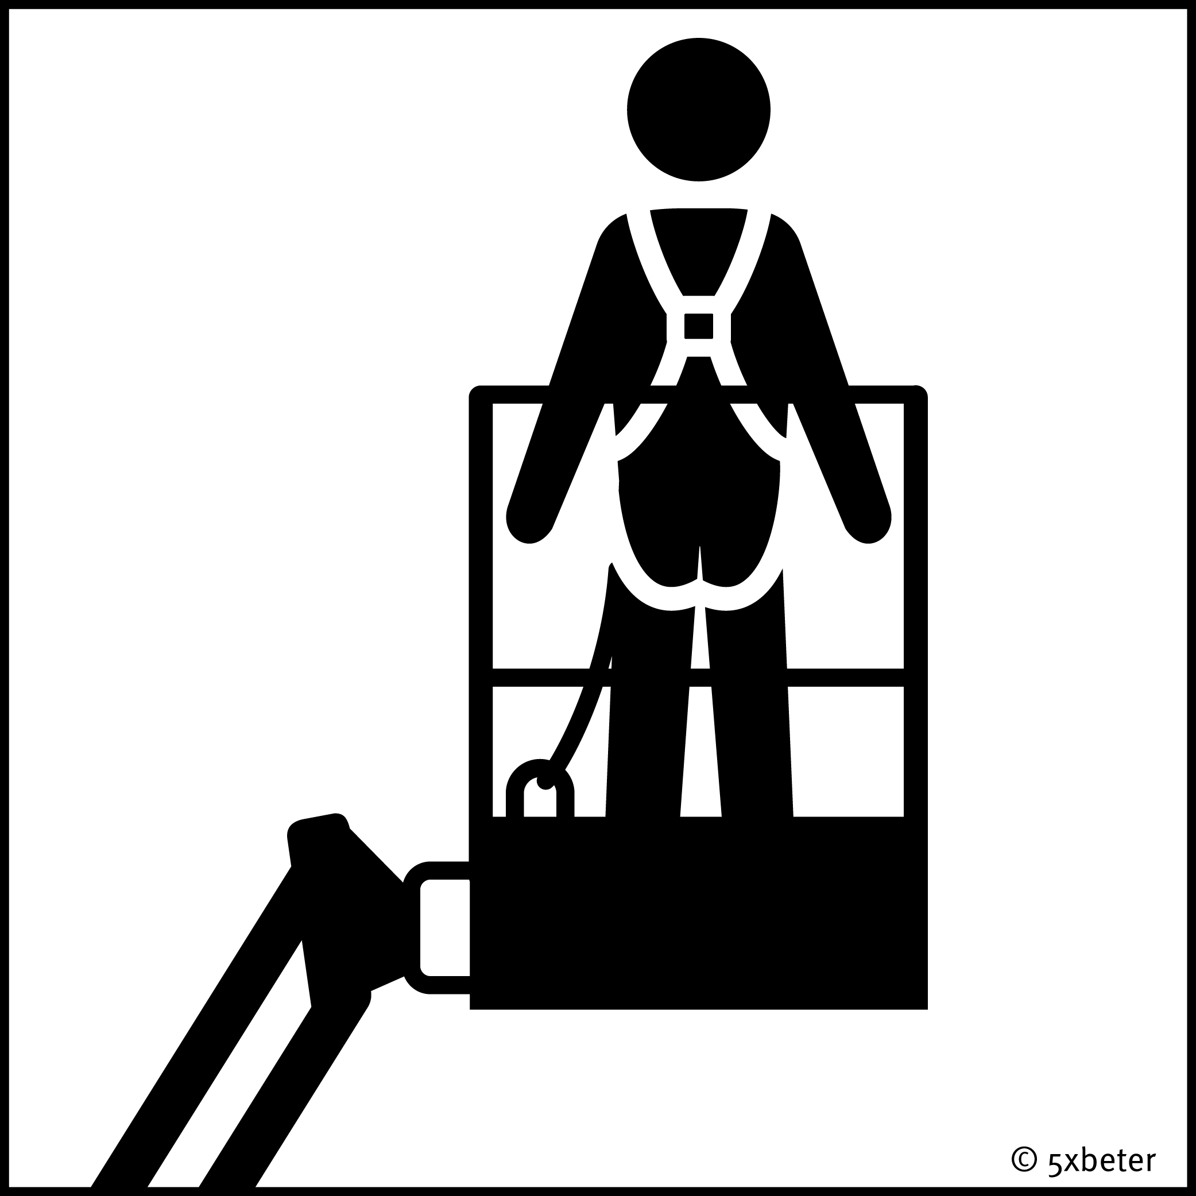
Safe and healthy working practices | Working at height - Fall hazard
Working safely with the aerial work platform
The surface is flat and load-bearing.
The operating instructions for the aerial work platform are clearly legible.
Working with the aerial work platform is prohibited in wind forces exceeding 6 Beaufort.
Driving with the aerial work platform is only permitted with the basket in the lowest position and without persons in the basket, unless driving at crawling speed on a flat floor.
Use fall protection as specified in the manual.
Only leave the aerial work platform when it has come to a complete stop and is in the retracted position, unless the aerial work platform has been specifically modified for this purpose by the manufacturer.
Ensure that an annual inspection is carried out by an independent expert.

Slide 11
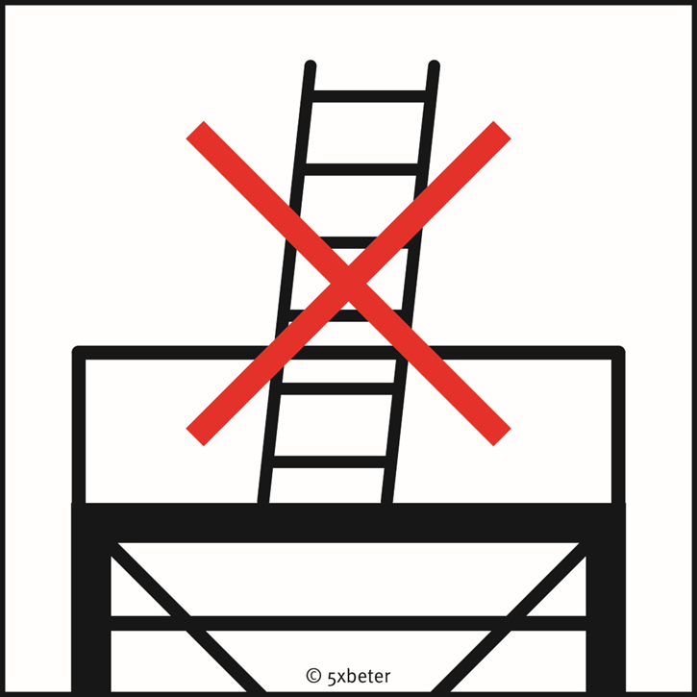
Safe and healthy working practices | Working at height - Fall hazard
Working safely on scaffolding
The maximum load capacity of the scaffolding is known.
The surface is flat and load-bearing.
The working platform of the scaffolding is at least 60 cm wide.
Toe boards or kick boards have been installed.
Handrails are present.
The working height has not been increased with ladders, steps, etc.
The castors of a mobile scaffold are braked.
The scaffold is not moved while someone is standing on it.
The scaffold is assembled according to the supplier's instructions.
Notes:
Annual inspection not relevant for (daily) use.

Slide 12
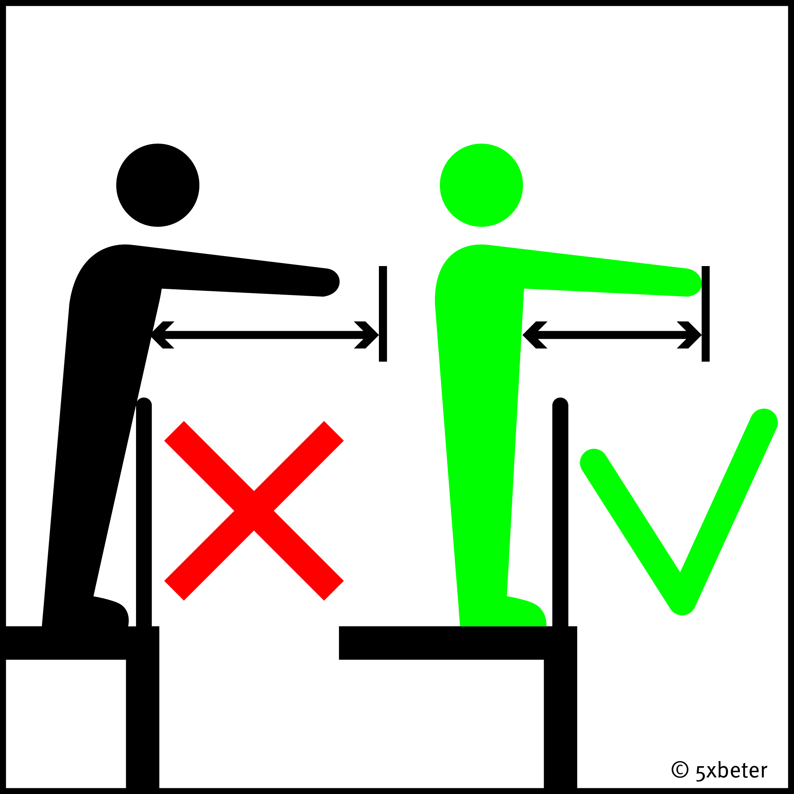
Safe and healthy working practices | Working at height - Fall hazard
Working safely with a ladder or step ladder
The standing height is a maximum of 5 metres.
The standing time per day is a maximum of 2 hours.
The maximum reach distance is 1 arm's length.
The maximum force exerted during work is 5 kg.
The maximum weight of aids/tools is 5 kg.
The ladder or step ladder is placed on a stable, solid surface.
There are provisions to prevent slipping.
Access ladders extend at least 1 metre above the access level, unless other provisions allow for a secure grip.
Always keep one hand on the ladder and ensure that carrying loads never hinders a secure grip.

Slide 13
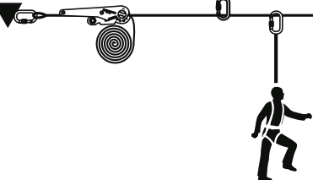
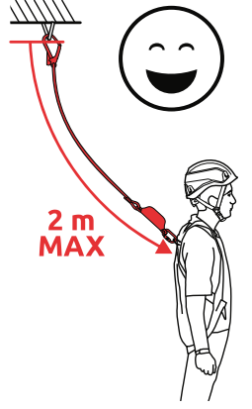
Safe and healthy working practices | Working at height - Fall hazard
Working safely with fall protection
A fall protection system consists of three components:
A fixed and sturdy attachment point for the safety line.
A harness belt that connects the user to the attachment point via the safety line.
A safety line or fall arrest device with automatic line tensioner or shock absorber (max. 2 metres).

Slide 14
Safe and healthy working practices | Working at height - Fall hazard
Working safely with fall protection
Is the harness belt suitable for the work to be carried out?
Is the total length of the safety line and shock absorber less than the height at which the work is being carried out - length of line + shock absorber + 1 metre margin>.
Is the pendulum effect (swinging back and forth) prevented in the event of a fall?
After a fall, the victim must be freed from the harness as quickly as possible.
Is the emergency response team equipped to provide the correct assistance?
Rescue of a suspended victim.
Prevent harness suspension trauma (hanging trauma).
Notes:
When someone falls and dangles in the harness, the harness's leg straps put pressure on the veins. This prevents blood from being pumped up from the legs effectively. Circulation eventually becomes so disrupted that blood pressure drops, nausea occurs, and oxygen levels plummet. Organ function, such as the kidneys, also deteriorates. This causes the person to become unconscious, and the chance of survival diminishes.
Harness suspension trauma can occur within half an hour, depending on the person, the fall, and the type of harness.
And if other injuries also occurred during the fall, rapid rescue is even more urgent.

Slide 15
Safe and healthy working practices | Working at height - Fall hazard
What can you do yourself?
Make sure you are well informed.
Report risks!
Comply with your company's health and safety policy.
Take the appropriate measures.
When in doubt: ask!

Slide 16

Safe and healthy working practices | Working at height - Fall hazard
Questions?
info@5xbeter.nl | www.5xbeter.nl

Slide 17
Safe and healthy working practices | Working at height - Fall hazard
Need help?
Discuss it with your manager or contact the health and safety officer.
Consult an Improvement Coach from 5xbeter: www.5xbeter.nl
Or call the FREE Improvement Line: 0800 – 55 55 005
info@5xbeter.nl | www.5xbeter.nl

